Slide 1
Basin Boundary Revision Proposal
Scotts Valley Water District
October 8, 2015

Slide 2
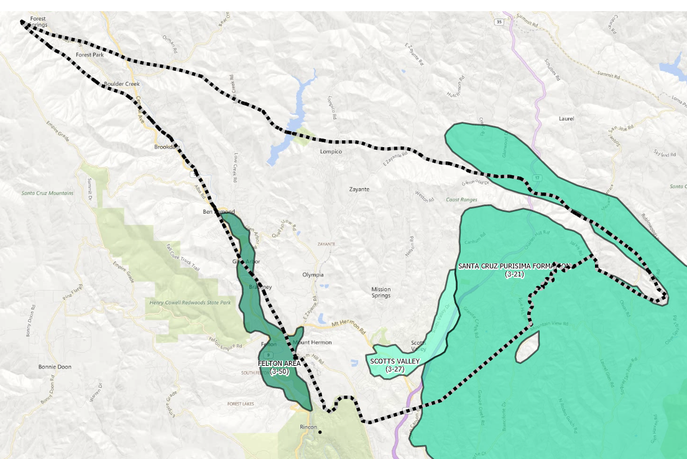
Purpose: Request DWR Recognize the Santa Margarita Groundwater Basin

Slide 3


Key Aspects of Boundary Request
Based on geologic boundaries wherever possible
Includes all of SVWD service area (not SLVWD)
Exclude City of Santa Cruz service area

Slide 4
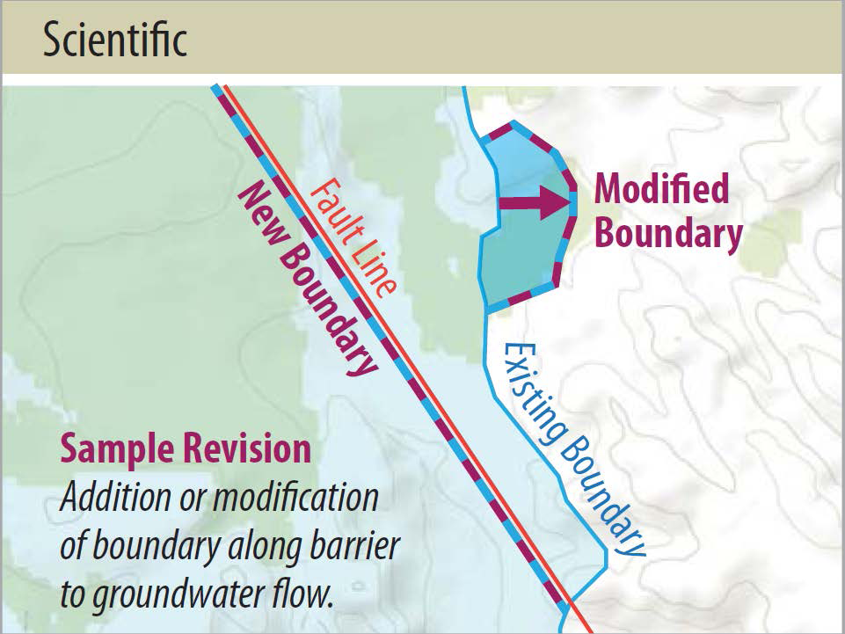
DWR Boundary Revision Types: Scientific

Slide 5
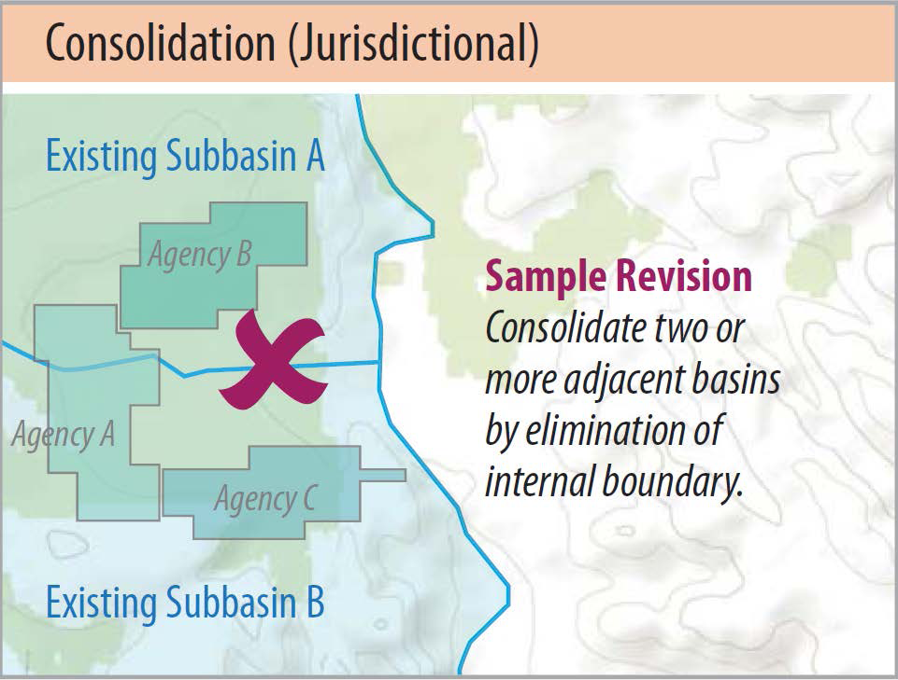
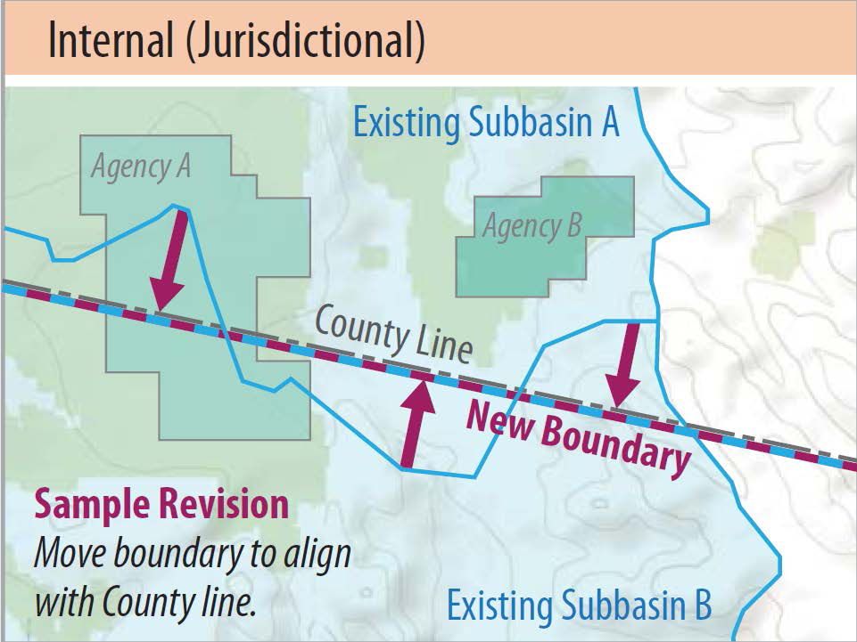
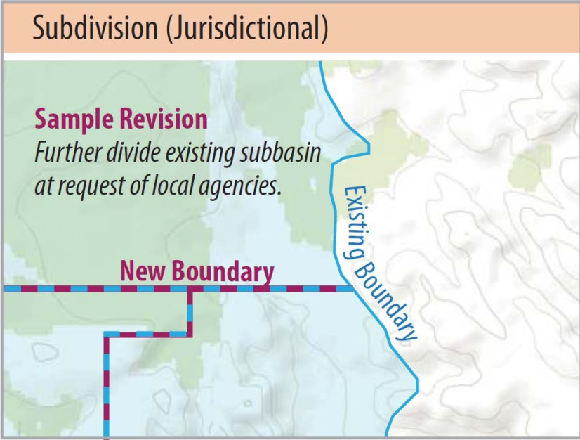
DWR Boundary Revision Types: Jurisdictional

Slide 6
Revision Application Requirements

Slide 7
Compressed Schedule
DWR Schedule
SVWD/SLVWD Schedule
October 16, 2015. DWR presents final regulations to California Water Commission.
November, 2015. DWR submits final regulations to OAL.
January 1, 2016 – March 31, 2016, DWR accepts boundary revision requests.
October, 2015. Begin technical work.
November, 2015. Review draft work with SMGBAC.
December, 2015. Present draft revision request to Boards of Directors (2). Incorporate comments.
January, 2016. Submit revision request to DWR.
2017. Bulletin 118 basin reprioritization.

Slide 8
Issues
Get early DWR acceptance of our approach DWR
Coordination with Soquel-Aptos work
Level of local support
Reprioritization timeline

