Slide 1
Summary of City of Santa Cruz Aquifer Storage and Recovery Investigations
Heidi Luckenbach, PE
Deputy Director/Engineering Manager
Santa Margarita Groundwater Agency
Board of Directors Meeting
October 27, 2022

Slide 2
Goal
Sufficiently describe the City’s ongoing process for determining feasibility of Aquifer Storage and Recovery to gain an understanding about the thorough, transparent and iterative nature of the work.

Slide 3
Topics
Santa Cruz Water System
  Sources, infrastructure, limitations
WSAC summary (2014 – 2015)
  Problem Definition & Augmentation Opportunities
  Preliminary Feasibility Analyses of Aquifer Storage & Recovery and IPR
Summary of work performed 2016 – present

Slide 4
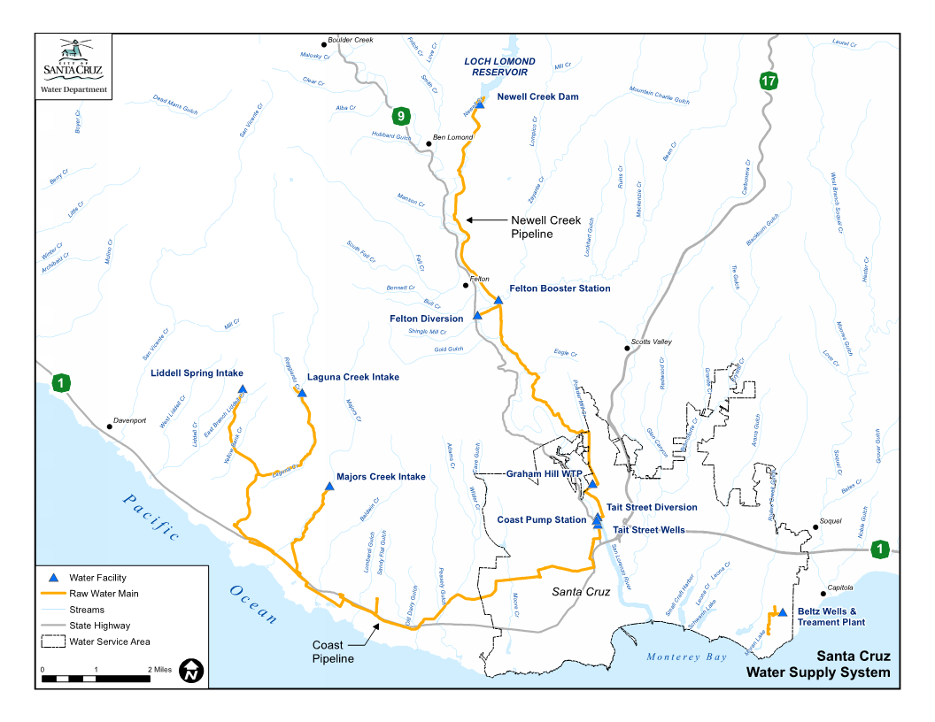
Santa Cruz Water Supplies

Slide 5
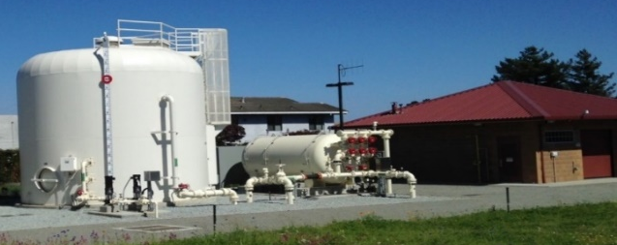

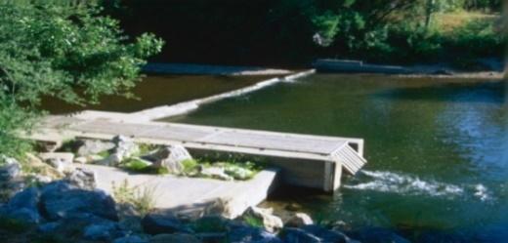
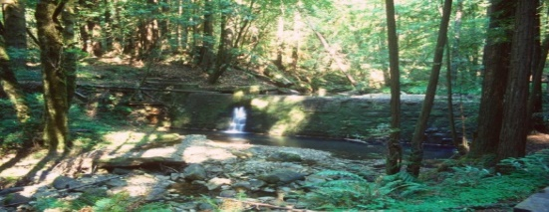
Santa Cruz Sources of Supply
Beltz Wells, ~4% (1964, 2013)
Loch Lomond Reservoir, ~22% (1960)
Tait Wells, ~3% ( 1960s, 2019)
San Lorenzo River, ~45% (1924)
North Coast Streams , ~25% (1880)

Slide 6
The Santa Cruz Water System Relies on Highly Variable Surface Water Resources

Slide 7
WSAC Agreements in General
WSAC Purpose: explore, through an iterative, fact-based process, the City’s water profile, including supply, demand and future risks; analyze potential solutions to deliver a safe, adequate, reliable, affordable and environmentally sustainable water supply; and, to develop recommendations for City Council consideration
WSAC Findings: For Santa Cruz to achieve reliability objectives, demand management and supply augmentation is needed to fill an agreed-upon worst year gap of 1.2 billion gallons.
WSAC Recommendations: pursue enhanced conservation, Groundwater storage with water transfers, exchanges and aquifer storage and recovery, and Recycled Water/Desalination

Slide 8
Four basic components of ASR/IPR feasibility
Source of Supply of water for injection
A system for the diversion , treatment and conveyance of water between source and storage basin
A suitable groundwater basin with available storage space
Wells to inject and recover the stored water
Ref: Pueblo Water Resources TM (May 2015), Reconnaissance-level Evaluation of ASR and IPR.

Slide 9
WSAC ASR/IPR Findings
Supply: Excess water from the San Lorenzo River or City WWTF
  Constrained by hydrology, instream flow requirements, demand
  Estimated 550mgy+ (1,700afy)
  IPR: WWTF has average summer flows through the outfall of ~6mgd
Infrastructure: Tait Diversion/GHWTP/Distribution System
  limited to 2mgd without upgrades (8mgd with upgrades to maximize ASR)
Basin Storage: Based on historical storage depletion
  MCGB: 3,290mg (10,100af) (HMWRI, 2012)
  SMGWB: 3,600 mg (10,990af) (KJ, 2013)
Per Well Injection: Evaluated 17 wells in the MCGB & 6 wells in SVWD
  MCGB: 0.5mgd (350gpm) per well
  SMGWB: 0.35mgd (250gpm) per well
Ref: Pueblo Water Resources TM (May 2015), Reconnaissance-level Evaluation of ASR and IPR.

Slide 10
WSAC Conceptual ASR Project: Phase 1
Infrastructure Improvements: None
Excess Treatment Capacity: 2mgd
Wells: 4
Average Annual Yield: 130mgy (400afy)

Slide 11
WSAC Conceptual ASR Project: Phase 2
Infrastructure Improvements: Tait Diversion & GHWTP
Excess Treatment Capacity: 8mgd
Wells: 17
Average Annual Yield: 500mgy (1,500afy)

Slide 12
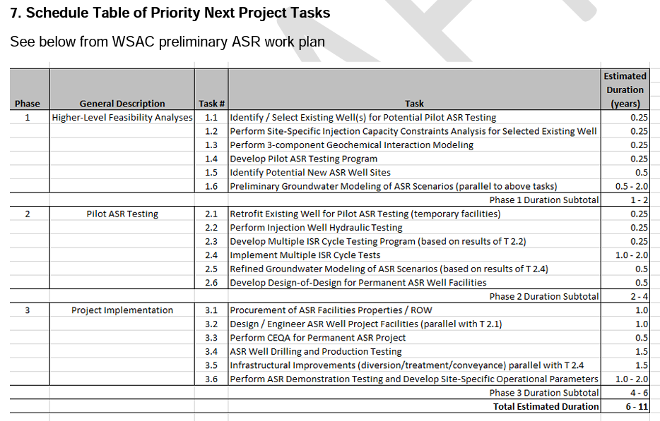
ASR Work Plan

Slide 13
Phase 1 – Feasibility
Task & Performance Measure
Develop/use groundwater model
  Up to 5mgd sustainable injection; no greater than 20% losses
Identify/select existing wells for piloting
  Suitable existing wells in target aquifers
Perform site-specific injection capacity (paper evaluation)
  Average injection capacity is at least 250gpm
Perform geochemical interaction modeling
  No well plugging
Develop ASR pilot test program
  NA
Identify sites for new ASR wells
  Sufficient sites are identified to build-out project

Slide 14
Phase 2 – Pilot Testing
Task & Performance Measure
Retrofit existing wells for pilot testing
  NA
Perform injection well hydraulic testing & use results to develop ISR (Injection/Storage/Recovery) test program
  Average injection capacity is at least 250gpm; no well plugging
Implement ISR program
  Long term inj/ext rates are sustainable; no impacts to neighboring wells; positive impacts to basin; no water quality issues
Additional Groundwater modeling
  Long term injection rates are sustainable; water available for injection
Develop basis of design for permanent facilities
  Costs are acceptable

Slide 15
Phase 3 – Permanent Facilities
Task & Performance Measure
Procure additional properties
  Sufficient sites available
Engineering design
  Affordability exceeded
CEQA, permitting, financing
  Complex or expensive
Construction
  NA

Slide 16
Work preformed since WSAC
Siting Study
Groundwater modeling
Pilot Testing
  Water Availability
  Water Quality
Regulatory Framework

Slide 17
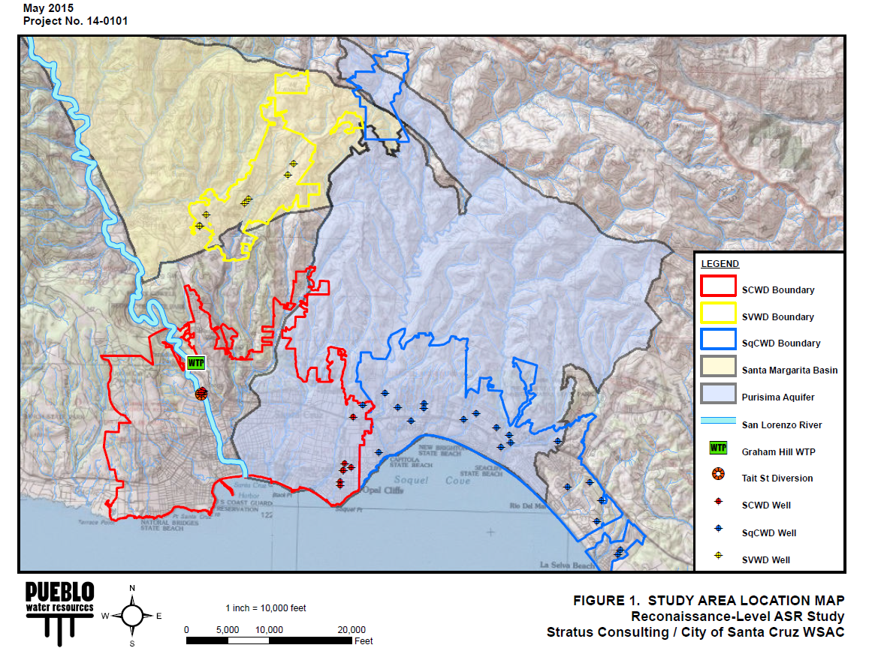
ASR Study Area
Ref: Pueblo Water Resources (May 2015) for City of Santa Cruz Water Supply Advisory Committee.

Slide 18
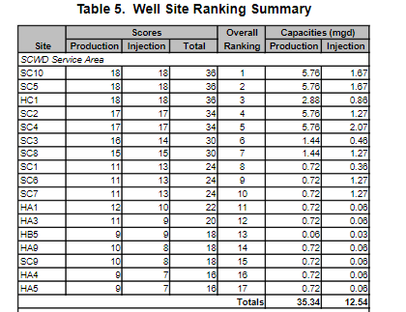
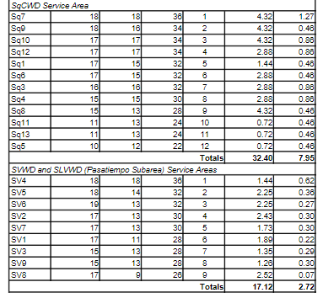
ASR Siting Study
Identified Existing Sites for development of ASR in SMGWB and MCGB. Selection criteria: hydrogeologic factors, site conditions, construction, regulatory, environmental.
Ref: Pueblo Water Resources (Oct 2020), Well Siting Study, Santa Cruz ASR Project Phase 1 Feasibility Investigation

Slide 19
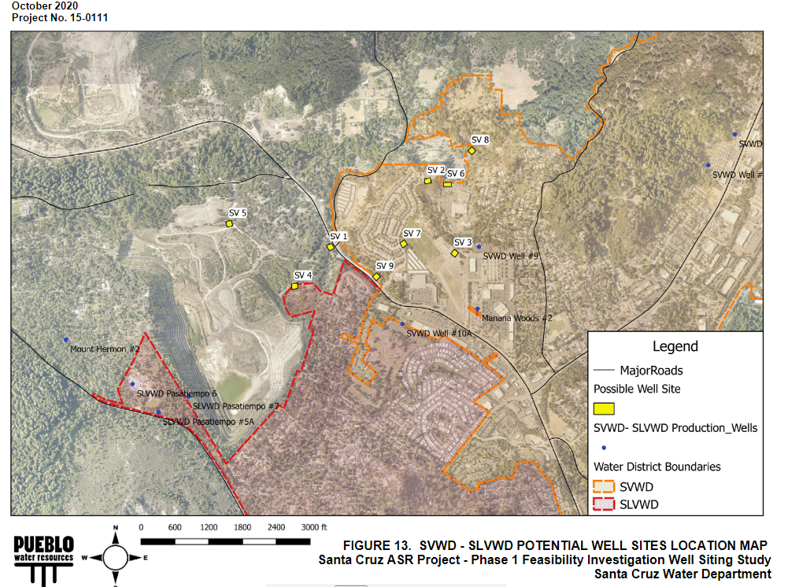

Slide 20
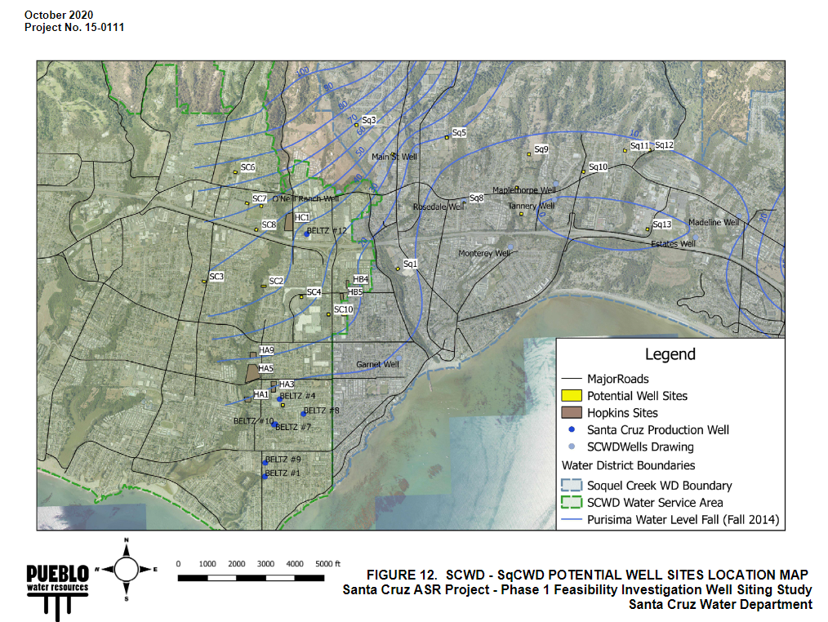

Slide 21
Summary: Siting Study
MCGB
  SCWD: 17 potential sites with estimated injection capacities ranging from 20-1440gpm
  SqCWD: 12 potential sites with estimated injection capacities ranging from 250 – 880gpm
SMGWB
  SVWD: 9 potential sites with estimated injection capacities ranging from 0.07-0.62mgd)

Slide 22
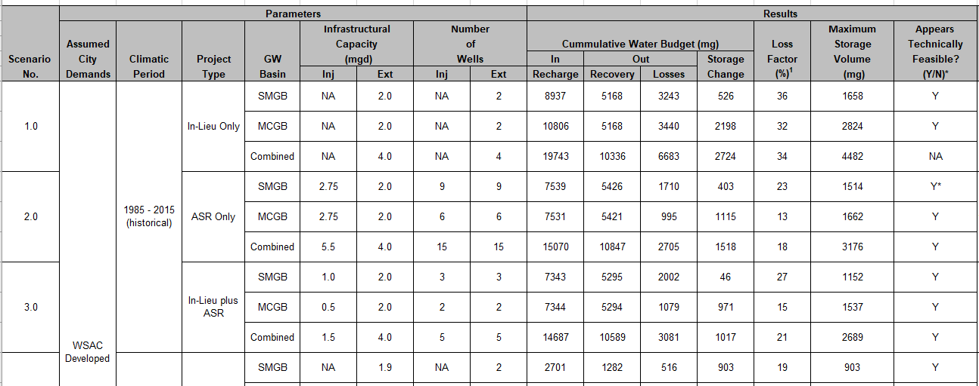
Groundwater Modeling
Ref: Pueblo Water Resources (Jan 2021), Santa Cruz ASR Feasibility Investigation; Summary of Initial Groundwater Modeling Results.

Slide 23
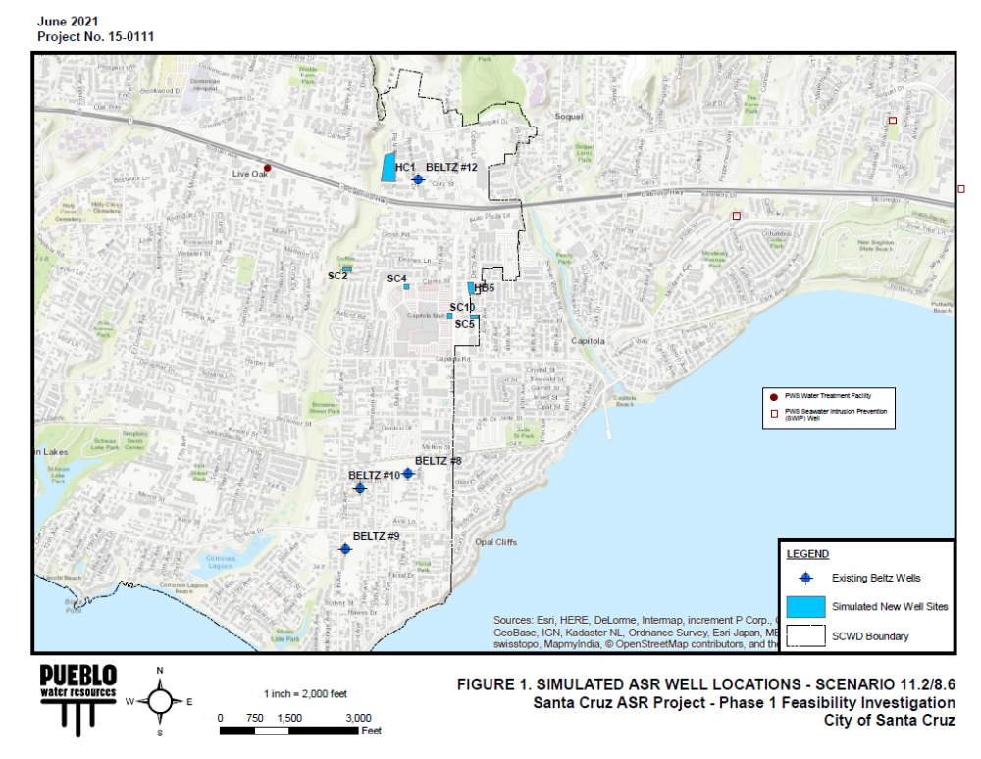
Groundwater Modeling: MCGB

Slide 24
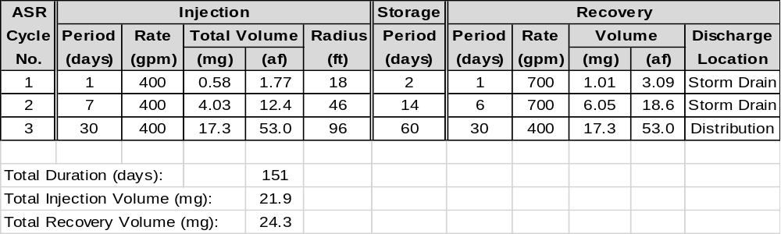
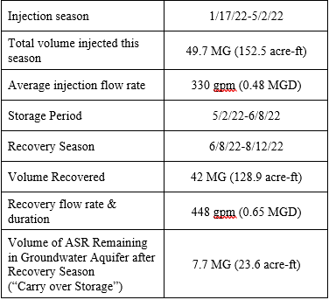
Pilot Testing
ASR Pilot Test at Beltz 12 (2019)
ASR Demonstration Test at Beltz 12

Slide 25
Pilot Testing/Water Quality
Regulated by the Regional Water Quality Control Board and Division of Drinking Water
Suite of required monitoring parameters of injected, stored and extracted water
Sampling locations include test well and monitoring well(s)
Performance Measures Highlights
  Arsenic
  Disinfectant Byproducts
  Ammonia
  Water availability

Slide 26
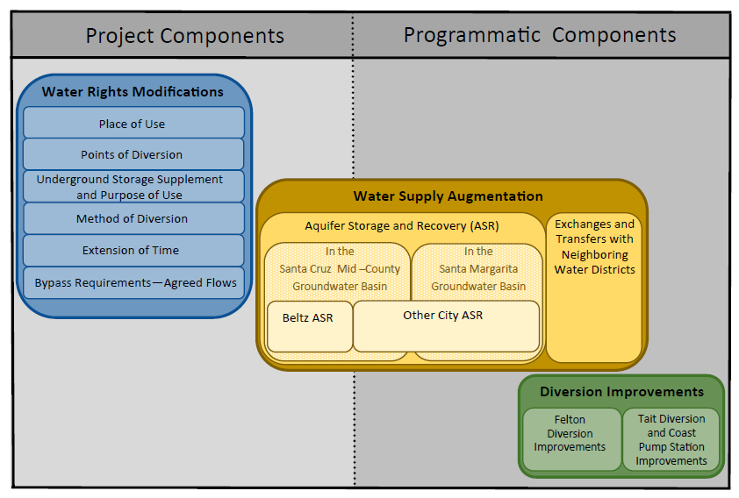
Water Right Modifications

Slide 27
Next Steps
Plan for ASR expansion in the Mid-County Groundwater Basin. Includes ongoing demonstration testing
Evaluate the opportunities for ASR in the Santa Margarita Groundwater Basin
Continue evaluating projects in both basins that may also include water transfers and exchanges
Maintain regional partnership and pursue grant/funding opportunities
Continue to evaluate the opportunities of recycled water either through groundwater replenishment in the MCGB or the SMGWB or long-term feasibility of direct potable reuse

Slide 28
Questions

