Slide 1
A Brief History of Regional Water Supply Plans and Projects
Notes:
The theme of this workshop is managing water in an uncertain time. The breakout session they just completed will have been an effort to push all participants to think like managers and decide what investments they would make to ensure that everyone has water.
The reality is that uncertainty has always been a factor but it is more pronounced now. Sometimes it takes the form of external conditions like climate change. Sometimes it takes the form of social or political behavior. This session is to discuss the past, present and potential future of integrated water management in this basin and region. The SMGWA Board has committed through its Guiding Principles to pursue integrated water management. This session is to describe what that is, what has been done historically and worked/ not worked, (as presented by you) what is happening right now and providing benefits to the region (as presented by Tim Carson), and what might the future hold for the basin and for the decision-makers of the SMGWA as they decide what if any actions need to be implemented to achieve and maintain sustainability (as presented by John).
I think you could then do a VERY quick summary of IWM as described in the Guiding Principles,

Slide 2
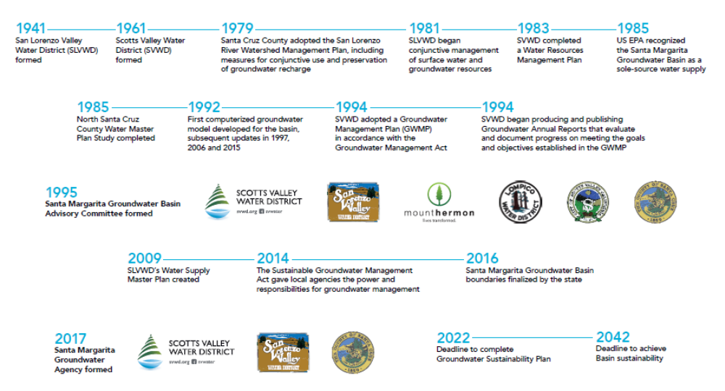

Slide 3
Early Industry and water use
Numerous small water companies and private users sprung up during the late 1800s and supported the communities as well as leather, lime, and lumber industries
Developers typically provided the water for the early settlements in the SLV
There was no concerted effort to conserve water, or the environment
Water laws changed in 1914 allowing for the formation of County Water Districts and restricting surface water use (to an extent)
Groundwater use was minimally used

Slide 4
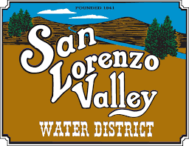
San Lorenzo Valley Water District
The San Lorenzo Valley Water District was formed in 1941 to begin coordinating water in the Valley.
The District has numerous pre-1914 surface water rights on tributaries to the San Lorenzo river
These are a legacy of industry and early development that was consolidated under the SLVWD
One appropriative right on Fall Creek

Slide 5


Slide 6

Scotts Valley Water District
Formed in 1961 by combining several private pumpers and assuming ownership of their wells.
No use of surface water

Slide 7
Regional Water Supply Planning
The County and water agencies have been working together and independently on water supply planning since the 1940’s.
Early studies focused surface water storage. Later studies acknowledge the need for conservation and supplemental supplies
Recommendations for recycled water and desal projects go back to the 1960s
Few considerations for environmental impacts until the 1980s as regulations and awareness increased.

Slide 8
Santa Cruz and Monterey Counties Investigation
Commissioned in 1948 and published in 1953 by the State Water Board
At the time, the population of the San Lorenzo Valley north of Felton was served by 24 small water companies which principally relied on direct surface diversion
Scotts Valley was served by several small water supply agencies diverting surface flows from Carbanero Creek, as well as a number of small private wells.
Recommended a degree of coordination and further study

Slide 9
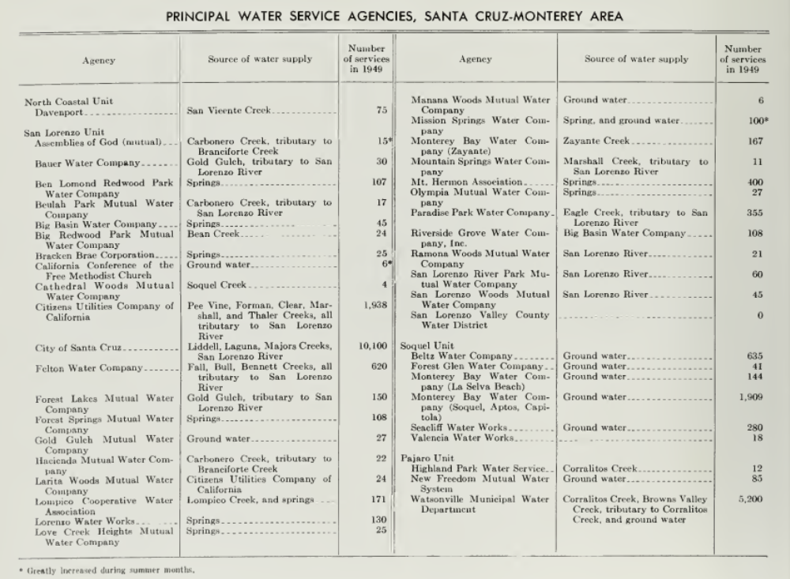
45 service connections in the San Lorenzo Unit (including Scotts Valley and Santa Cruz) using solely groundwater in 1949.

Slide 10
Report on Santa Cruz County Master Plan of Water Development
Written for the County of Santa Cruz in 1957 and identified the following problems:
  The supply for the City of Santa Cruz was only adequate in average rain years or better
  There were no storage reservoirs
  Data collection throughout the County was inadequate

Slide 11
Report on Santa Cruz County Master Plan of Water Development cont.
Suggested 6 storage reservoirs throughout the County:
  Newell Creek (later dammed to create Loch Lomond)
  Zayante Creek
  Glenwood
  Upper Soquel
  Aptos
  Scott Creek
No consideration of flow requirements for fisheries

Slide 12
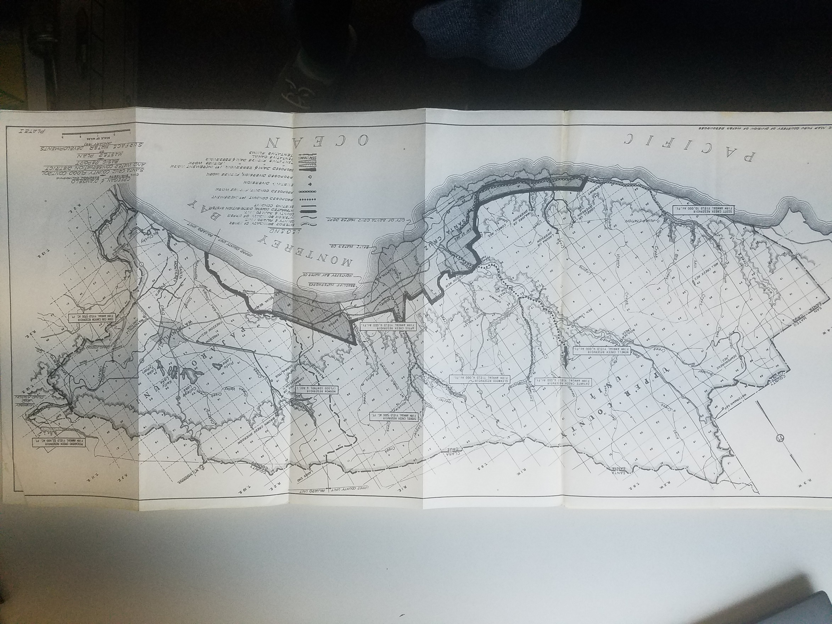
Zayante Creek Reservoir, yield 4,000AFY
Soquel Creek Reservoir, yield 5,000AFY
Glenwood Reservoir, yield 4,000AFY
Mormon Reservoir, not recommended
Newell Creek Reservoir, yield 4,000AFY
Aptos Creek Reservoir, yield 4,000AFY
Corn Cob Canyon Reservoir, Monterey County
Scott Creek Reservoir, yield 10,000AFY

Slide 13
Water Master Plan
Written for the County in 1968 to plan for water supply through 2020.
In addition to the previously recommended surface water reservoirs and increased groundwater pumping, the Plan considered:
  17,000 AFY of San Felipe canal imported water to be available by 1977 for Pajaro
  17,000 AFY of Waste Water Reclamation available by 2020 in Santa Cruz.
  Desalination was also recommended but at the time the technology was too new to be reliable.
  No water use efficiency

Slide 14
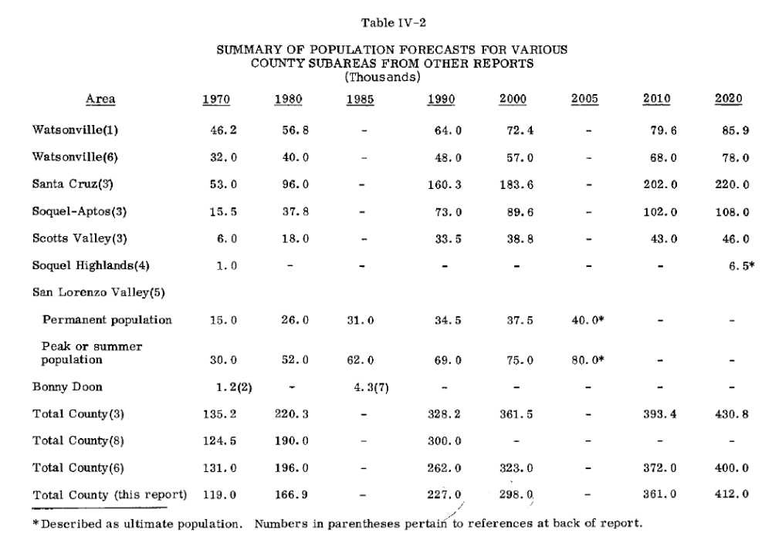

Slide 15
Distilled Seawater
1971- Master Plan of Water Development Using Distilled Seawater to address questions raised in the Water Master Plan
Focused on constructing a desalination plant near Davenport and Moss Landing
Concluded that a desal plant in Davenport that would blend water at the Graham Hill Treatment Plant was a viable option but should not delay other actions in the 1968 plan.

Slide 16
North Santa Cruz County Water Master Plan
1985 – Prepared by a Joint Powers Authority
Observed regional opportunities to augment supply and proposed a City-only alternative.
Some of these alternatives included
  Conservation and leak control programs,
  Interties,
  Zayante Creek dam
  Scotts Valley/SLV groundwater wells,
  Baldwin Creek off stream reservoir,
  Pump station at Majors Creek diversion,
  City of Santa Cruz groundwater wells,
  Glenwood dam

Slide 17
City of Santa Cruz Water Master Plan
1989 - City of Santa Cruz Water Master Plan – takes conservation into account
  Wastewater Reclamation, Enlarging Loch Lomond, Interties with Scotts Valley Water District and Soquel Creek Water District
  A reservoir projects on a small waterway either in the upper San Lorenzo Watershed or North Coast.

Slide 18
Conclusions
Coordination/integration of water supply in this region has been ongoing for 80 years.
Planning for Regional Projects have also been ongoing
This need will be even greater as we move into an uncertain future
The SMGWA guiding Principle #14 gets to the heart of this.

